Slide 1
Multiplayer Snake Game
Alexander Hauer

Slide 2
Project Overview
A Java-based application to play the classic Snake game.
Supports both singleplayer and multiplayer modes.
Features a background-changing mechanic based on user’s current location.

Slide 3
Project requirements
Singleplayer mode
Local multiplayer mode
Server multiplayer mode
Game speed selection
Weather API integration for game background change
GUI start-up implementation

Slide 4
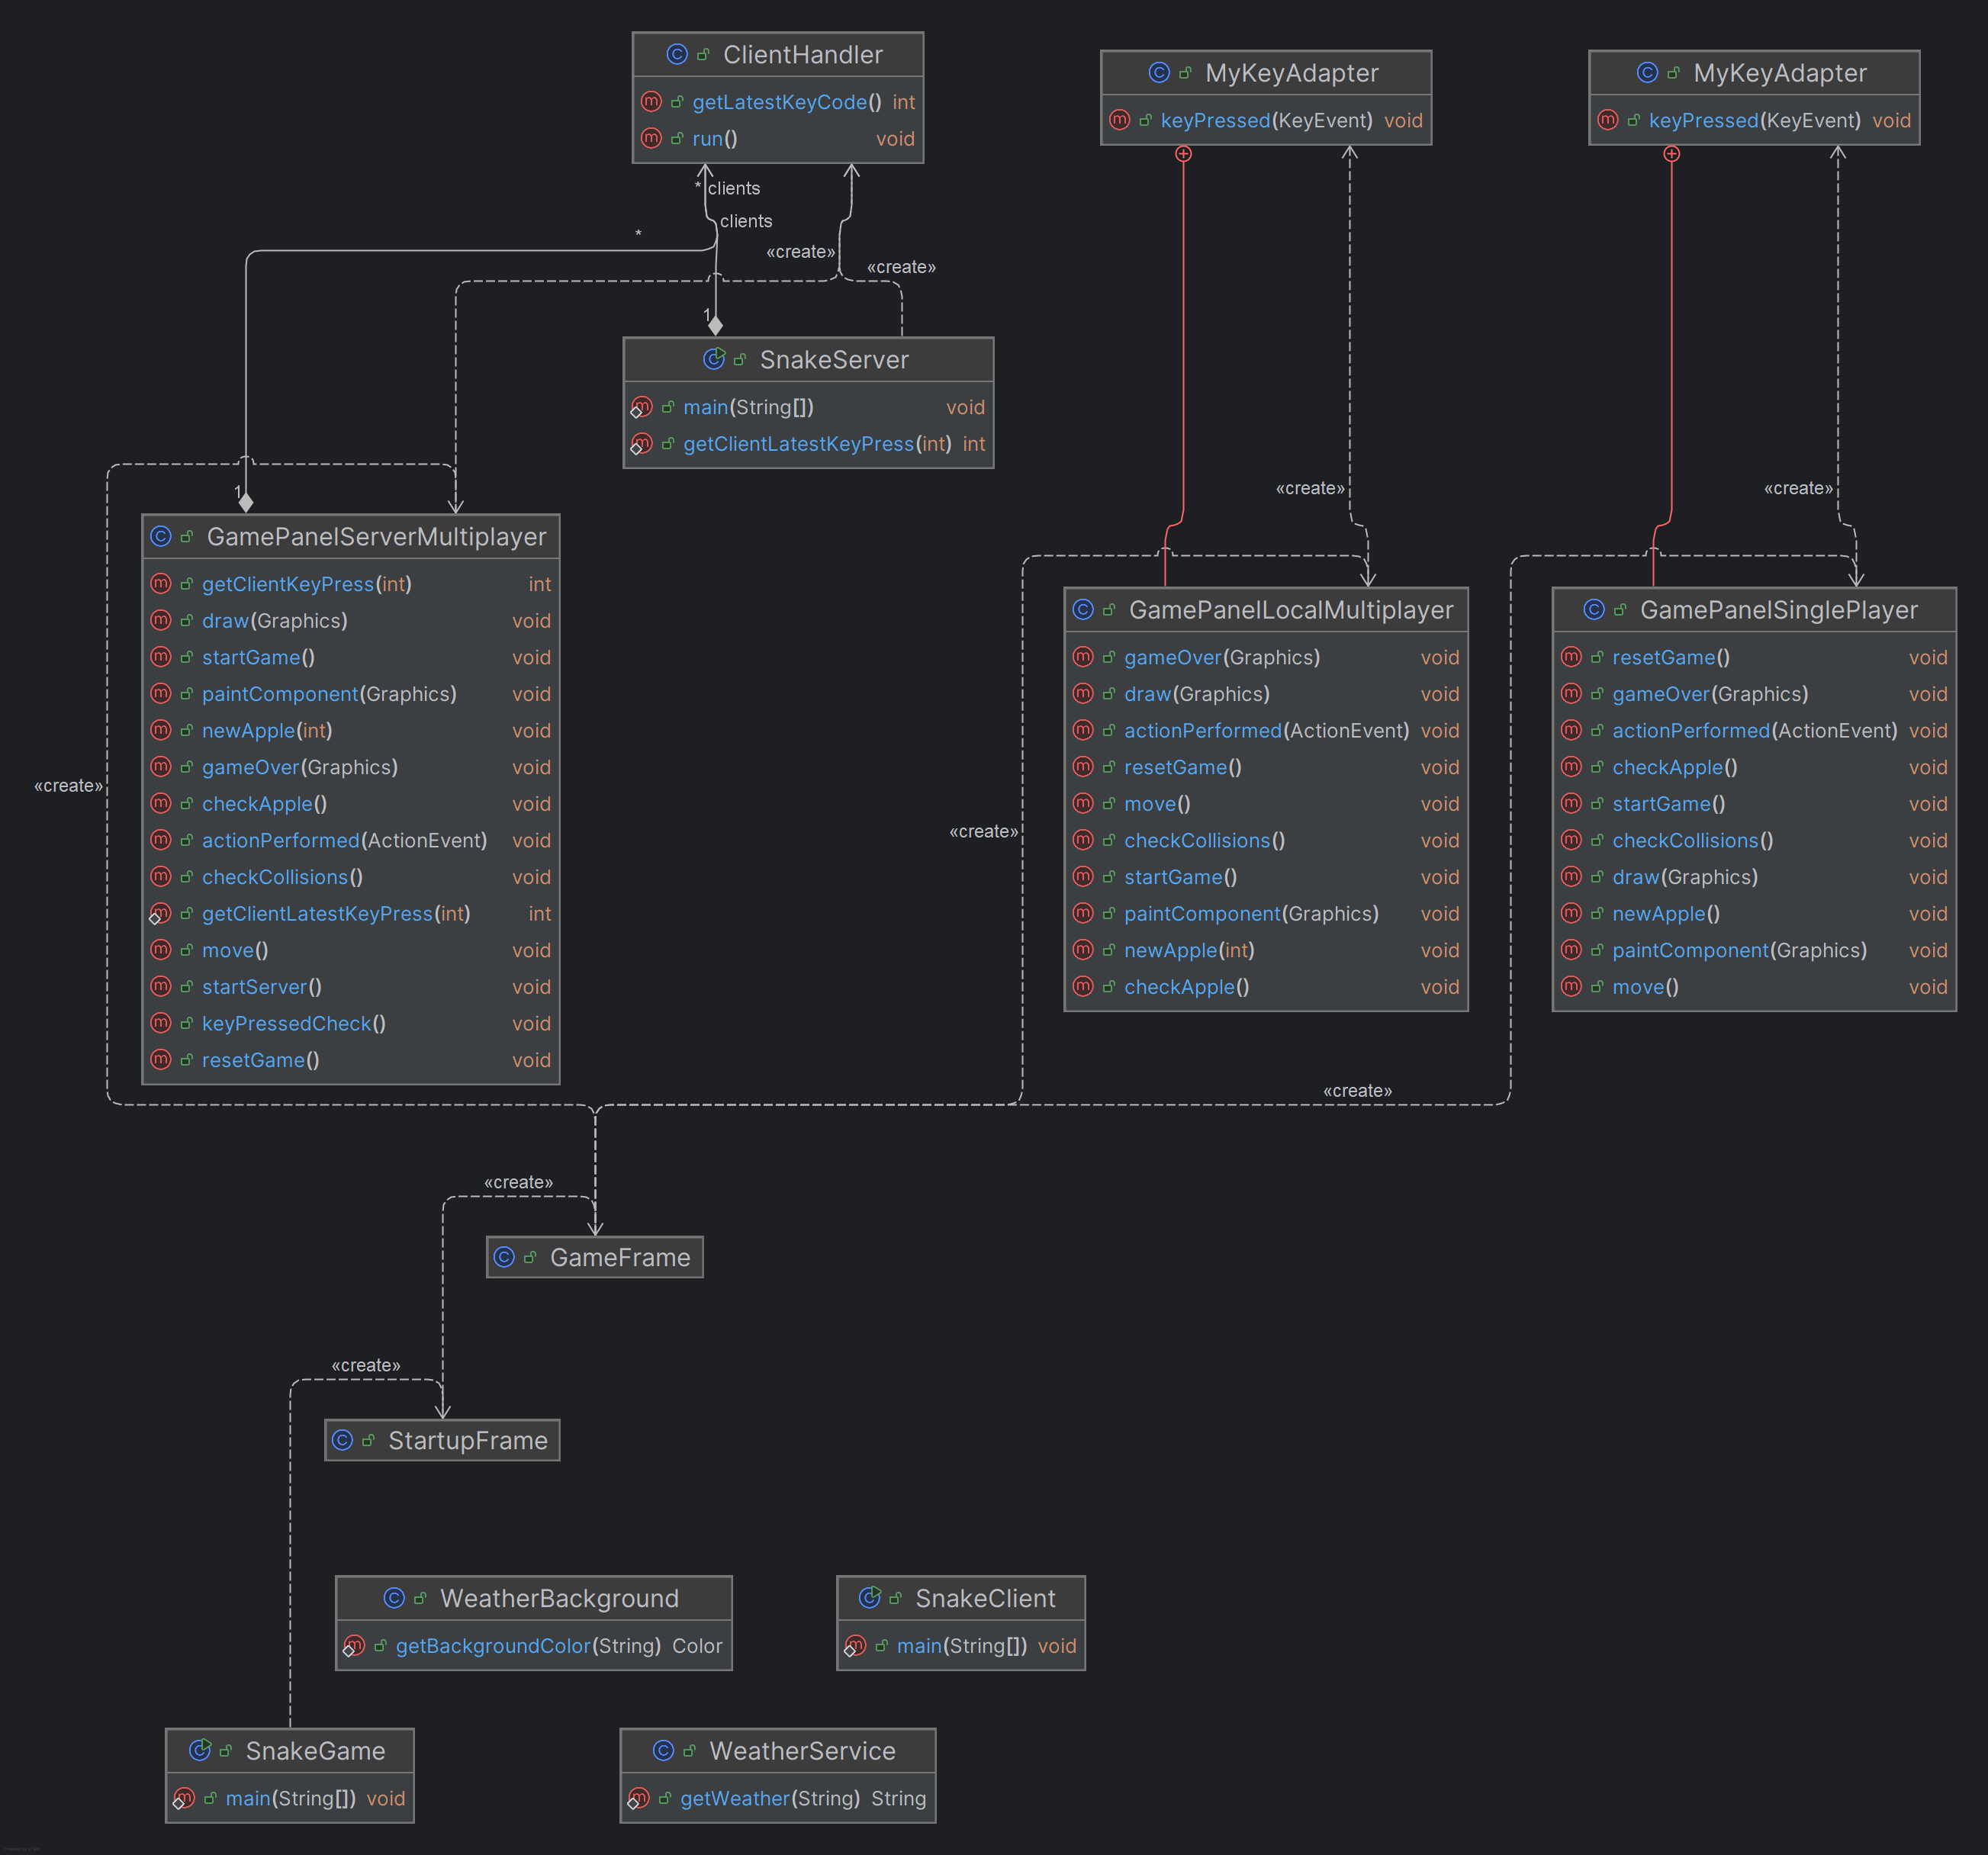
Software architecture
UML diagram

Slide 5
Explanation of diagram
SnakeGame, StartupFrame and GameFrame
----------------------------------------------------------------------------------
GamePanelSinglePlayer
GamePanelLocalMultiplayer
----------------------------------------------------------------------------------
GamePanelServerMultiplayer
SnakeClient
ClientHandler

Slide 6
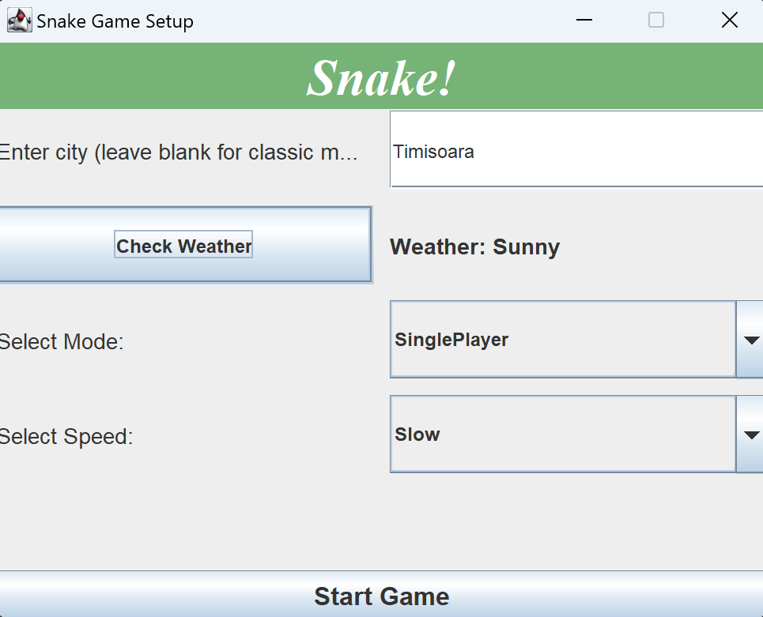
Start-up
SnakeGame – creates the game
StartupFrame – mode selection =====➔
GameFrame – player count selection (if required)

Slide 7
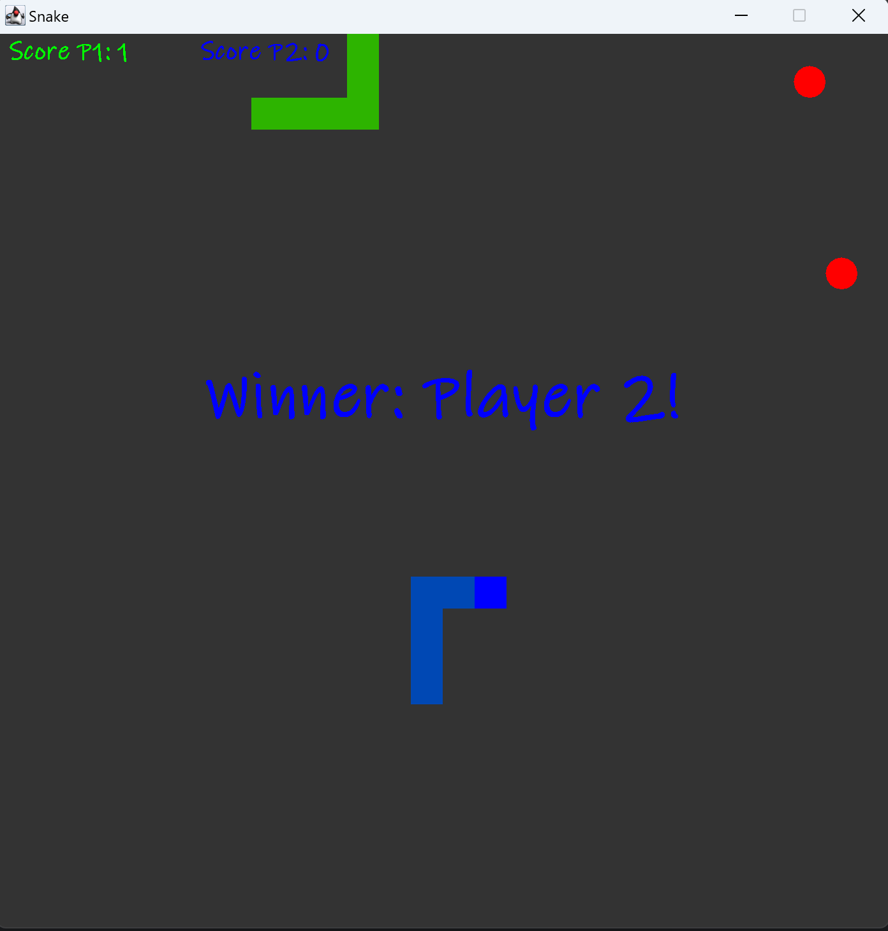
Simple game modes
Singleplayer – the foundation of all the game modes
Local Multiplayer up to 4 players
using (arrow keys, WASD, IJKL, Numpad)

Slide 8
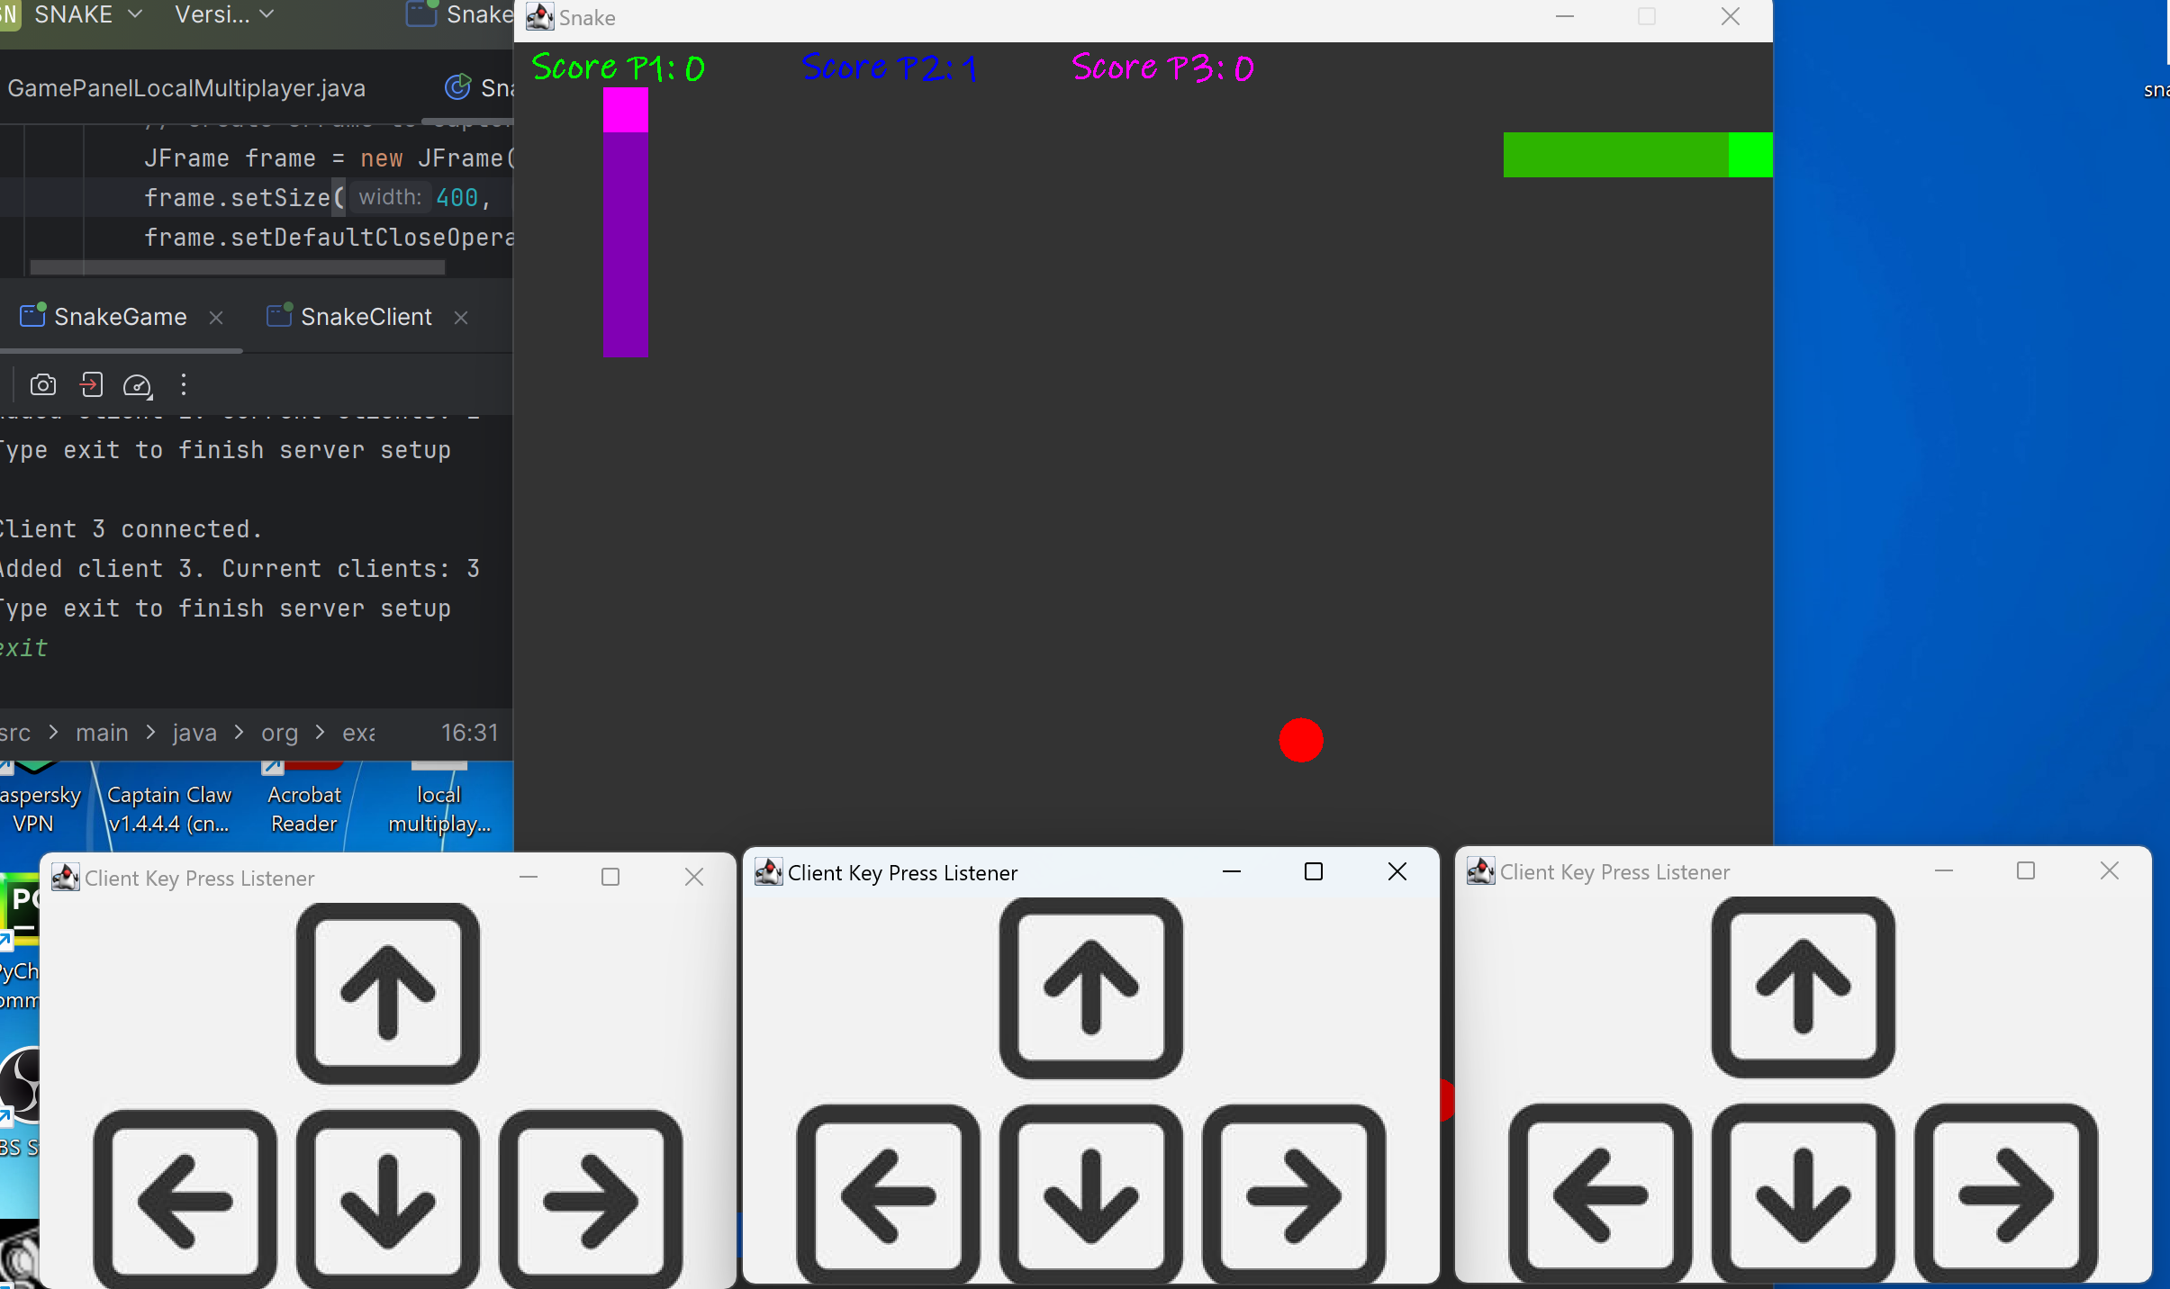
Server multiplayer
GamePanelServerMultiplayer – similar to the local multiplayer mode. Is the server
SnakeClient – represents the connected user and their GUI window
ClientHandler – handles client ID and their latest key for the server to receive

Slide 9
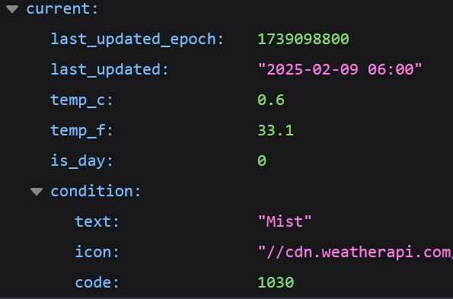

API call
Uses WeatherAPI
It extracts the current weather from the response
The background changes accordingly

Slide 10
Future work
Server to client communication
Support for more than 4 players
Singleplayer campaign

Slide 11
Thank you
for your attention!

